Slide 1
Sysco Team 9 Predictive Maintenance: NASA Engines ML IoT

Slide 2
Project Goal
Challenges
Solutions
Create an advance ML model that is able to predict Remaining Useful Life (RUL) on an engine after each run cycle to improve the Predictive Maintenance process.
Build a Linear Regression model that determines the success or failure of an event. Use the series of data in train data to calculate the likelihood of success/failure based on the operational setting and sensor data.
Determine the total number of cycles each engine ran for in each train data set.
*This is a naive assumption, that the degradation starts at the very first cycle. Deeper understanding and research can performed to find the threshold value when actual degradation could have started to get a more accurate RUL.***

Slide 3
# End Goal Calculate the remaining useful life after each engine run cycle. The Maintenance Department will use the information to determine when to perform preventative maintenance on an engine. This timing improvement will minimize engine down time resulting in increased production output and lower costs.

Slide 4

ETL
Extract
Source: Data is captured from engines running at NASA.
From an s3 bucket
s3://sagemaker-us-east-1-023375022819/PredictiveMaintenance-Team-9/input/CMAPSSData
Extracted via Sage Maker Jupyter Notebook

Slide 5
Data Transformation
ETL
For each Type of dataset: FD001, FD002, FD003, FD004.
Create a new variables for Conditions:
1 - ONE (Sea Level)
2 – SIX
FaultMode:
1 – ONE (HPC Degradation) or
2 – TWO (HPC Degradation, Fan Degradation)
Remove unnecessary NAN columns
Concatenate then
data is split and loaded to csvs
One-Hot Encoding
Create columns:
condition-1, condition-2, faultMode-1, faultMode-2.
Create target variable, output (RUL),
Add a column that calcuates the remaining useful life for each engine by taking the total cycles an engine ran and subtracting it by the cycle number
Model Ready
Concatenate then
data is split and loaded to csv(s)
Then stored within SageMaker.
Data consumed for training , testing by the model .
Hyper parameters:
Hyper tuning:

Slide 6
Our Model Regression Model xgboost

Slide 7
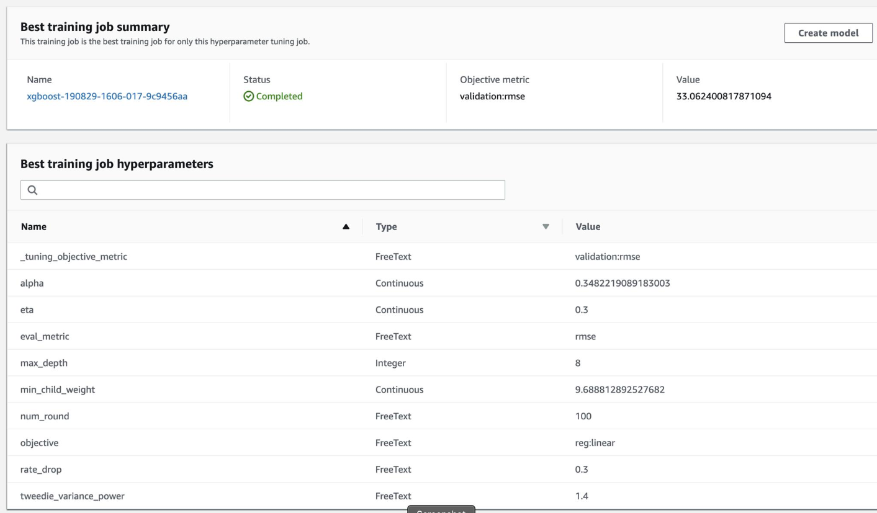

Slide 8
Static Hyperparameters "max_depth":"5", "eta":"0.2", "gamma":"4", "min_child_weight":"6", "subsample":"0.7", "silent":"0", "objective":"reg:linear", "num_round":"50" From the Logs: train-rmse:32.2 validation-rmse:36.0253 Hyperparameter Tuning Parameters eta': ContinuousParameter(0.3, 0.7), 'min_child_weight': ContinuousParameter(5, 10), 'alpha': ContinuousParameter(0, 2), 'max_depth': IntegerParameter(4, 8) Best Model Training Job Summary

Slide 9
Training the XGBoost model
After setting training parameters, we kick off training, and poll for status until training is completed.
Run time is dependent on the hyper parameter settings.

Slide 10
Create endpoint configuration
SageMaker supports configuring REST endpoints in hosting with multiple models and testing purposes. In order to support this, customers create an endpoint configuration, that describes the distribution of traffic across the models, whether split, orsampled in some way. In addition, the endpoint configuration describes the instance type required for model final deployment.

Slide 11
PRODUCTION DESIGN

Slide 12
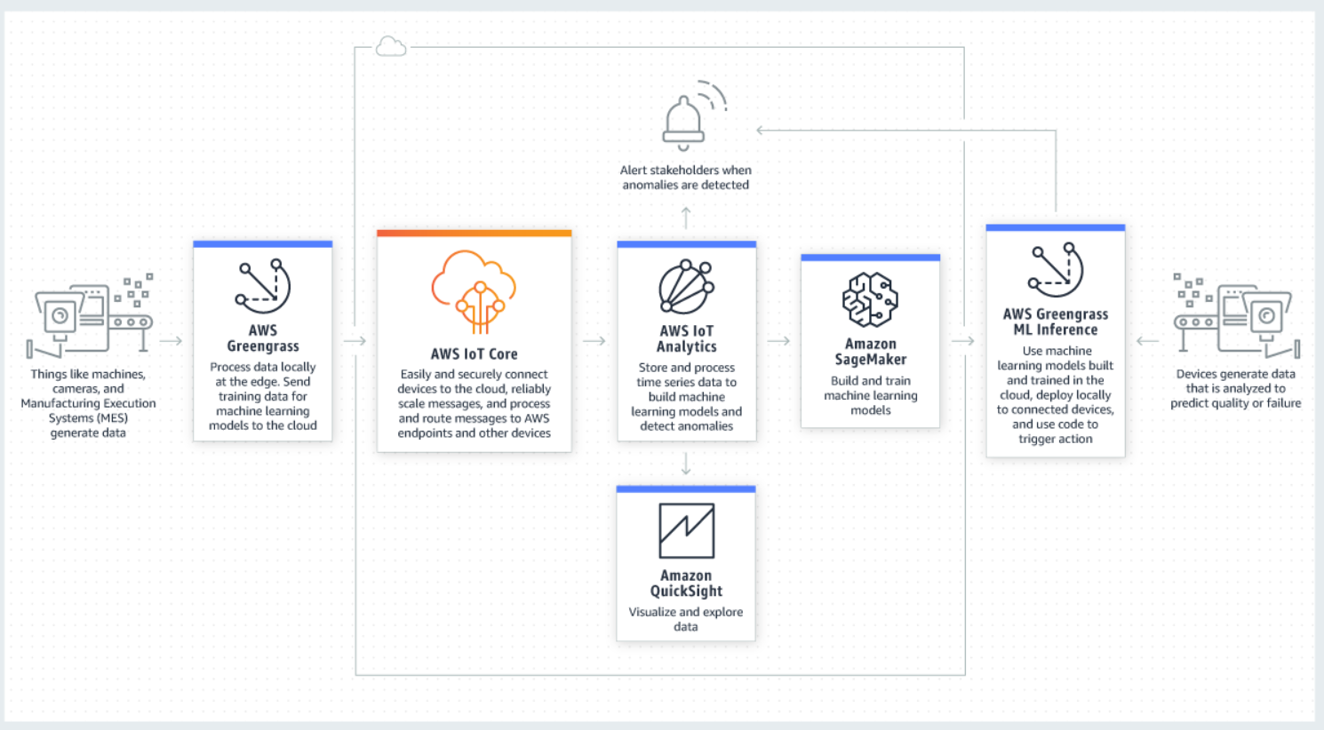

Slide 13
Utilize our current Sysco Technology Stack

Slide 14



















SEED Architecture
Collect
Store
ETL
Analyze
Consume
A
Amazon
ElastiCache
Hot
Amazon Redshift
Amazon
QuickSight
Web Apps
Amazon DynamoDB
Interactive
Analysis & Visualization
Applications
AWS
Lambda
Search SQL NoSQL Cache
Fast
Transactional Data
Amazon RDS
Amazon
ES
Amazon Elastic MapReduce
S3
Warm
Search Data
Hot
Batch
Slow
Notebooks
Cloud watch
Amazon S3
Logging
File Storage
File Data
Fast
AWS Datapipeline
Cold
IDE
Apps & APIs
Interactive Analytics
Amazon Redshift, Spark
Batch Processing
EMR , Hive, Spark, Lambda
Analysis Tools and Frameworks

Slide 15

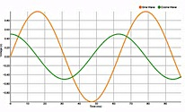
Future Research … Real-time Analytics
Amazon
SNS
KCL
Alert
Notifications
Amazon Kinesis
AWS Lambda
Amazon
ElastiCache (Redis)
Producer
DynamoDB Streams
Spark
Streaming
App state
Amazon
DynamoDB
Apache
Storm
Amazon
RDS
KPI
Amazon
ES
process
Real-time Prediction
store
Amazon
ML
Notes:
Best practices
BDT318 - Netflix Keystone: How Netflix Handles Data Streams Up to 8 Million Events Per Second
Use Kinesis or Kafka for stream storage
Use appropriate stream processing tool
KCL – Simple, only for Kinesis
Apache Storm – general purpose
Spark Streaming – Windowing, MLlib, Statefull
AWS Lambda – fully managed, no servers, stateless
Use Amazon SNS for Alerts
Use Amazon ML for predictions
Use a managed database/cache for state management
Use a visualization tool for KPI visualization

Slide 16
Summary
Use the right tool for the job
Latency, throughput, access patterns and deploy
Use Lambda architecture ideas
Serverless and Immutable (append-only) log, batch/speed/serving layer
Be cost conscious move
Big data ≠ big cost
Notes:
Before we go into solving the Big architecture, I want to introduce some “tried and test” architecture principles.
Here at AWS we believe you should be using the right tool for the job – “instead of using a big swiss army knife for using a screw dreive, it will be best to use a screw drive - this is especially important for big data architectures. We’ll talk about this more.
Decoupled architecture http://whatis.techtarget.com/definition/decoupled-architecture - In general, a decoupled architecture is a framework for complex work that allows components to remain completely autonomous and unaware of each other…this has been tried and battle test.
Managed services – this is relatively now - Should I install Cassandra or MongoDB or CouchDB on AWS. You obviously can. Sometimes there are good reasons for doing this. Many customers still do this. Netflix is a great example. They run a multi-region Cassandra and are a poster child for how to do this. But for most customers, delegating this task to AWS makes more sense….you are better of spending your time on building features for your customers rather than building highly scalable distributed systems.
Lambda Architecture -

Slide 17
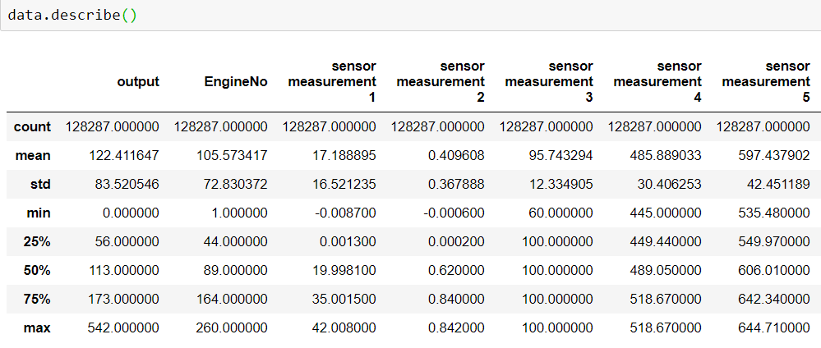
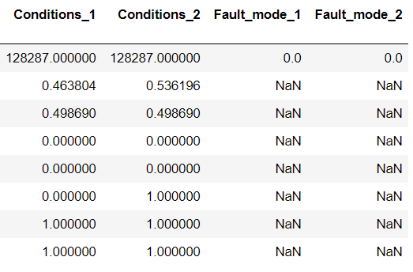
Explorative Data Mode :Process / Analyze
Interactive Jupyter Notebook→ Interactive analytics
Notes:
Analysis of data is a process of inspecting, cleaning, transforming, and modeling data with the goal of discovering useful information, suggesting conclusions, and supporting decision-making.
Examples:
Data Warehousing: Monthly bill, Interactive dashboards
Machine Learning: Sentiment Analysis, Prediction
Stream processing: Alerts, 1 minute metrics, etc.
http://www.jmlr.org/papers/volume9/li08a/li08a.pdf
Forecasting Web Page Views:
http://nlp.stanford.edu/sentiment/
http://nlp.stanford.edu/sentiment/Methods and Observations
https://en.wikipedia.org/wiki/Data_analysis

Slide 18
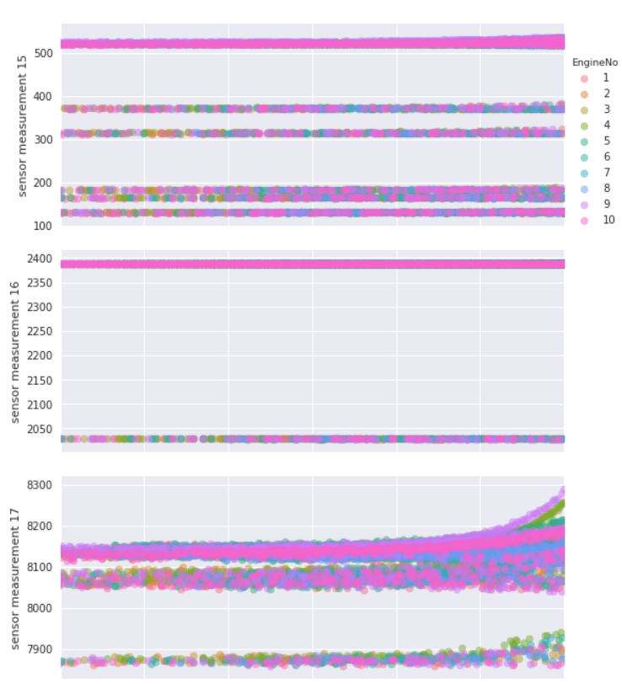
Exploratory Data Analysis
Look at how the sensor measures evolve over time (first column) as well as how they relate to each other for a subset of the units.
For first 10 Engines
Notes:
Analysis of data is a process of inspecting, cleaning, transforming, and modeling data with the goal of discovering useful information, suggesting conclusions, and supporting decision-making.
Examples:
Data Warehousing: Monthly bill, Interactive dashboards
Machine Learning: Sentiment Analysis, Prediction
Stream processing: Alerts, 1 minute metrics, etc.
http://www.jmlr.org/papers/volume9/li08a/li08a.pdf
Forecasting Web Page Views:
http://nlp.stanford.edu/sentiment/
http://nlp.stanford.edu/sentiment/Methods and Observations
https://en.wikipedia.org/wiki/Data_analysis

Slide 19
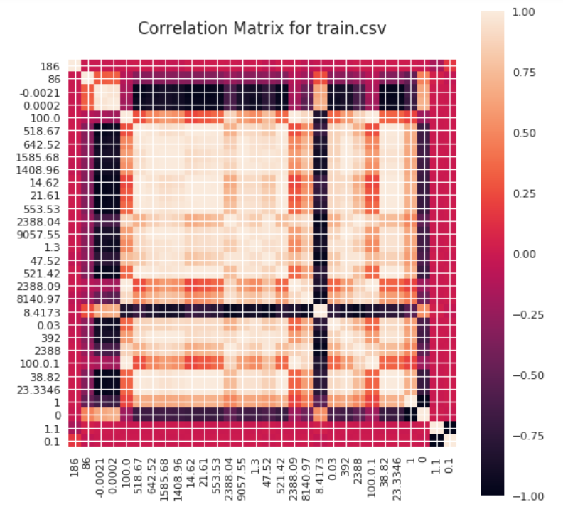
Attempt on Confusion Matrix

